Slide 1

Department of Computer Science and Engineering
Smartphone Price Patterns Prediction Using
Machine Learning Algorithms
PRESENTED BY
Y. Rambabu (21471A05B6)
P. Rajasehkar (21471A05B5)
B. Suhas (21471A0578)
Under the Guidance of,
Dr. Shaik Rafi _{M.tech.,(Ph.D)}
Associate Professor,
Department of Computer Science and Engineering,
Narasaraopeta Engineering College (Autonomous),
Narasaraopet- 522 601.

Slide 2
OUTLINE
Abstract
Introduction
Literature Survey
Research Gaps
Problem Statement
Objectives
Block Diagram / Flow Diagram
Methodology
Implementation
Results and Analysis
Conclusion & Future Scope
References
Question and Answers
Acknowledgements

Slide 3
ABSTRACT
Selecting the best smartphone can be challenging due to the wide range of models available on the market. This study shows how the machine learning models can predict mobile phone prices based on their features. We evaluated several machine learning techniques, including Logistic Regression, Decision Trees, Random Forest, SVC, K-Neighbors Classifier, Gaussian Naive Bayes (GaussianNB), AdaBoost, Gradient Boosting, Extra Trees, Bagging Classifiers, and XGBoost. The primary objective was to identify the most effective model for price forecasting and to investigate the factors influencing phone prices. Our research offers insights to both consumers and manufacturers, helping them make more informed decisions about phone features and pricing. We emphasize the importance of using diverse datasets that accurately represent various smartphone models and pricing points. Key factors affecting phone costs were identified, and model performance was assessed using metrics such as accuracy, F1-score, and classification reports. Model performance was further enhanced through hyperparameter tuning with GridSearchCV, achieving 97% accuracy with the Decision Tree, K-Neighbors Classifier, SVC, AdaBoost, and Random Forest models. Among these, the Decision Tree and SVC was selected as the optimal models, offering a good trade-off between accuracy, flexibility, and time complexity. This study aims to provide valuable data to guide consumers in making informed choices about mobile phone features and price ranges.

Slide 4
INTRODUCTION
Project Overview: Smartphone Price Patterns Prediction Using different Machine Learning Algorithms with Hyper-Parameter tuning, Identifying the best model based on accuracy and time complexity.
Motivation: Low accuracies of models, No proper feature engineering & Trained limited number of models in previous existing paper.
Importance, Relevance: Prediction of mobile phone price patterns helps consumers make informed choices and allows manufacturers to optimize pricing strategies. This study enhances market transparency and improves price prediction accuracy using advanced machine learning techniques.

Slide 5
LITERATURE SURVEY
No | Title | Author | Journal Name & Year | Methodology Adapted | Key Findings | Gaps
1 | Analysis of feature selection and data mining techniques to predict student academic performance | m.kumar, c.sharma, s.sharma, n.nidhi, n.islam | 2022 international conference on decision aid sciences and applications (DASA) | Preprocessing, feature selection, datamining algorithms(decision tree, jrip, random forest). | Impact of feature selection, effectiveness in different subjects. | Limited datasets, less preprocessing techniques
2 | Inclusive and relative analysis of nature inspired optimization algorithms in reference to sworn intelligence | Tushar sharma,upindar kaur,shamneesh sharma | 2022 8th international conference on signal processing and communication (ICSC) | Nature inspired algorithms, pseudocodes, serach agents in population. | Optimal search agent count, comprehensive understanding of Nioas. | Low Accuracies of models ,used less number of models to predict the result
3 | Predicting trends and research patterns of smart cities using latent Dirichlet allocation . | Chetan sharma, isha batra, Shammesh sharma, arun malik | IEEE 13 oct 2022 | Data clustering,latent dirichlet, allocation (LDA). | Integration of IOT, topic modeling results. | Trined less less number of models
4 | Forecasting the prices using machine learning Techniques: Special reference to used mobile phones | Frank bodendorf, Stefan merbele, jorg franke. | ICAISS ,2023 Second international conference on augmented intelligence | ML algorithms, Data preprocessing, Normalization, GridSearchCV. | Best hyper-parameter tuning methods. | No outliers detection, Feature engineering

Slide 6
No | Title | Author | Journal Name & Year | Methodology Adapted | Key Findings | Gaps
5 | Early stroke prediction using machine learning | Sharma, Chetan, Shamneesh Sharma | (DASA), IEEE (2022). | ML models | Emphasized the importance of lifestyle factors in stroke prediction. | reducing model effectiveness over time.

Slide 7
RESEARCH GAPS
Low accuracies of models
No proper feature engineering
Trained limited number of models(ML Algorithms)
Used less number of data preprocessing techniques

Slide 8
PROBLEM STATEMENT
Identifying mobile phone price patterns is challenging due to the wide variety of models and rising prices. Machine learning can help predict prices by analyzing key factors, helping consumers make better decisions and manufacturers set competitive prices. This provides valuable insights for both groups.
Significance:
This study provides valuable insights for consumers and manufacturers by accurately predicting mobile phone prices, helping optimize purchasing decisions and pricing strategies.

Slide 9
OBJECTIVES
Developing a Reliable mobile price pattern Prediction Model
Enhance Model Performance and Accuracy
Choosing best model for prediction of result
Improving Consumer Decision Support
Deployment of Real-time Application

Slide 10
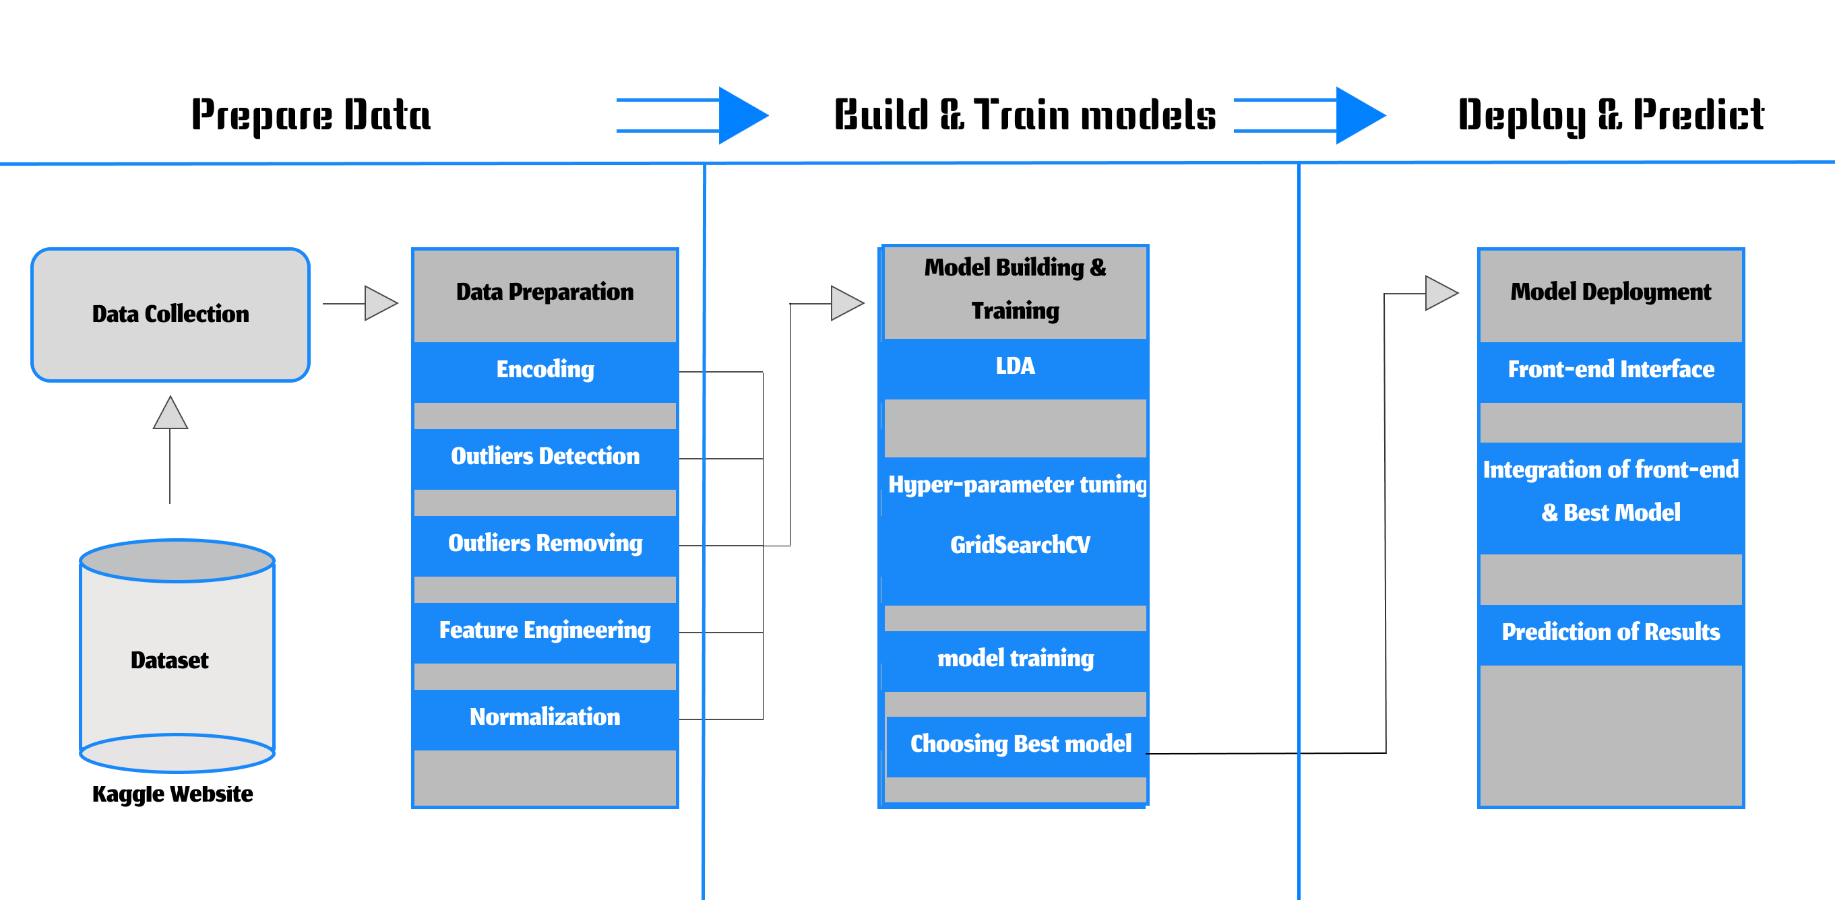
BLOCK DIAGRAM OR FLOW DIAGRAM

Slide 11
METHODOLOGY
1)Data Collection
Kaggle dataset
2)Data Preprocessing
Encoding
Outliers Identifying & Removing
Feature Engineering
Normalization
Linear Discriminant Analysis
3) Model Training & Testing
Creating Hyper-parameter grids for each algorithms
GridSearchCV(Model, hyper-parameter grid)
Choose best model based on Accuracy and time complexity
4) Web Application Integration

Slide 12
IMPLEMENTATION
Data Set
Data collection:
Source: Kaggle (Mobile price pattern Prediction Dataset)
Size: 2000 records, 21 features
Target Variable:- Price_range : 0 (low cost),1(medium cost), 2(high cost), 3(very high cost)
Remaining variables: (Independent variables)
Categorical : has-4g, touch-screen, bluetooth, dual-sim, wifi & has-3g.
Numerical : ram, mobile-wt, Battery-power, Int-memory, Px-height, Px-width, talk-time,
Sc-w, Sc-h, N-cores, M-dep, fc (front-cam-m pixels), pc(Primary Cam mega pixels), Clock speed.

Slide 13
Data Set
Data Preprocessing:
Data Cleaning:
No missing values: Verified using “ isnull().sum() ” .
No duplicate records: Verified using “ duplicated() ”
Data Transformation OR Encoding : used (Label Encoder method)
Categorical features encoded as :
Price range:- Low Cost (0), High Cost (2),
Medium Cost (1), Very High Cost (3) .
has-4g,
touch-screen,
bluetooth, are encoded into binary (if YES 0 & NO 1).
dual-sim,
wifi & has-3g

Slide 14
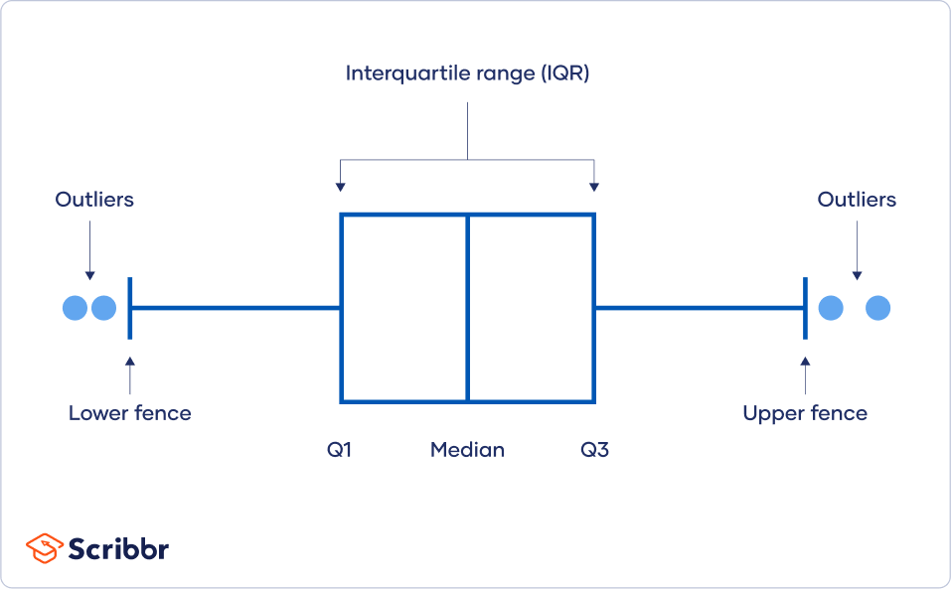
Data Set
Outliers Identifying & Removing :
Outliers are dirty and noisy data in dataset.
Outliers are values at the extreme ends of a dataset.
IQR (interquartile range):- useful for Removing and Identifying outliers
Sort your data from low to high
Identify the first quartile (Q1),
the median,
and the third quartile (Q3).
Calculate your IQR = Q3 – Q1
Calculate your upper fence = Q3 + (1.5 * IQR)
Calculate your lower fence = Q1 – (1.5 * IQR)
Outliers are identified in fc(front-camera-m pixels), px-height, three-g.
Outliers are removed from affected rows using IQR. After the dataset size is 1506 X 21

Slide 15
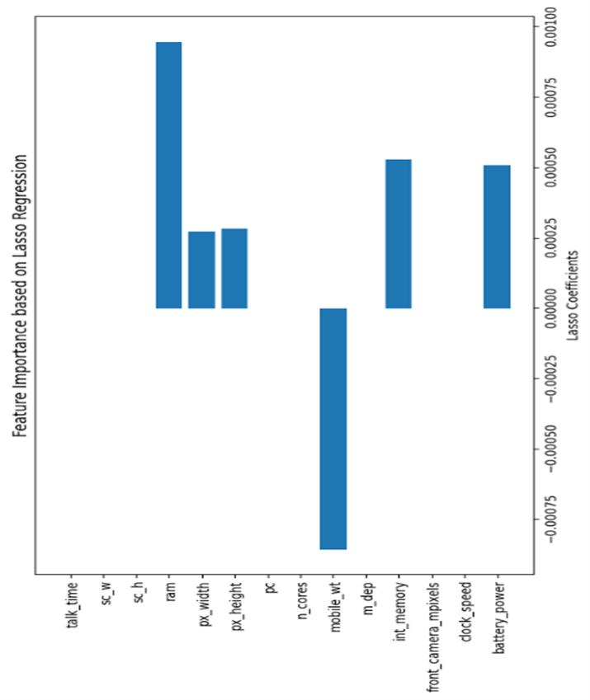
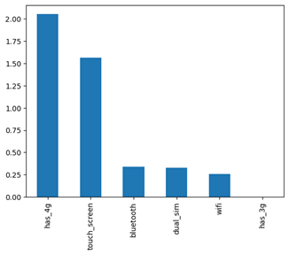
Feature Engineering : The dataset consist of 21 feature. out of 21, there some insignificant feature are present. So, to identify and remove those features through feature selection technique.
Categorical feature selection: Selected features are
has_4g, touch_screen, bluetooth, dual_sim, Wifi.
Numerical feature selection: Selected features are
Mobile_wt, int_memory, battery_power, px_height, px_width, ram
Chi-Square
Lasso Regression

Slide 16
After Feature Engineering the dataset size is 1506 X 11 Normalization:
Using stand scalar method
We applied normalization to the Dataset
Purpose:
It is technique useful for converting numerical data between 0 and 1,ensuring consistency, improving model performance
Normalization is used to ensure that all variables in a dataset have a similar range.
Benefits:
Normalized data is easy for machine to understand and execute operations quickly.

Slide 17
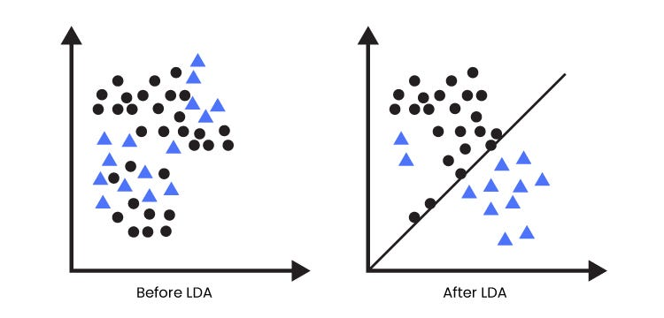
Linear Discriminant analysis(LDA):
We applied LDA to the dataset.
Purpose:
LDA separates multiple classes with multiple features through data dimensionality reduction.
Mainly it maximize the distance
between groups or classes.
Benefit:
LDA helps to optimize machine
learning models.

Slide 18
Model Training and Testing:-
Data Set
Hyper-Parameter Tuning:--
Created a Hyper-Parameter grids for each algorithms
Models are :Logistic Regression Random Forest Classifier, K-neighbors Classifier, SVC(), GaussianNB, Decision Tree Classifier, AdaBoost Classifier, Gradient Boosting Classifier, ExtraTreesClassifier, Bagging Classifier, XGB Classifier.
Applied model and hyper-parameter grid to GridSearchCV
GridSearchCV( Model , Hyper-Parameter grid ):-
Purpose : GridSearchCV is a function that performs hyper-parameter tuning by training and evaluating a ML model using different combinations of hyper-parameters.
Benefit : Powerful tool for hyperparameter tuning in machine learning and can be used to find the best set of hyperparameters for a given model and dataset.

Slide 19
RESULTS & ANALYSIS
Algorithm | Accuracy | F1-Score | Execution Time
RandomForest | 97.01% | 97.01% | 73.67 sec
DecisionTree | 97.01% | 97.01% | 1.84 sec
LogisticRegression | 96.68% | 96.68% | 8.16 sec
KNN | 97.35% | 97.35% | 19.11 sec
SVC | 97.35% | 97.35% | 2.63 sec
GradientBoosting | 96.35% | 96.35% | 159.85 sec
AdaBoost | 97.35% | 97.35% | 33.17 sec
GaussianNB | 96.68% | 96.68% | 0.20 sec
ExtraTrees | 96.02% | 96.02% | 913.33 sec
Bagging | 96.35% | 96.35% | 299.63 sec
XGBoost | 96.68% | 96.68% | 638.68 sec

Slide 20
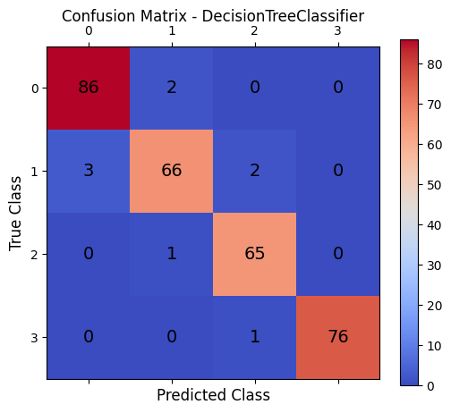
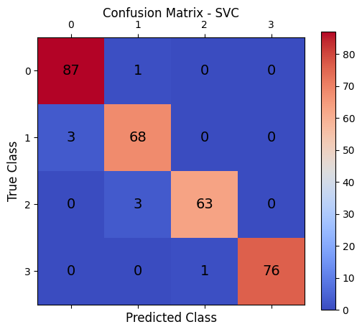
RESULTS & ANALYSIS
Confusion Matrix for Decision Tree Confusion Matrix for SVC

Slide 21
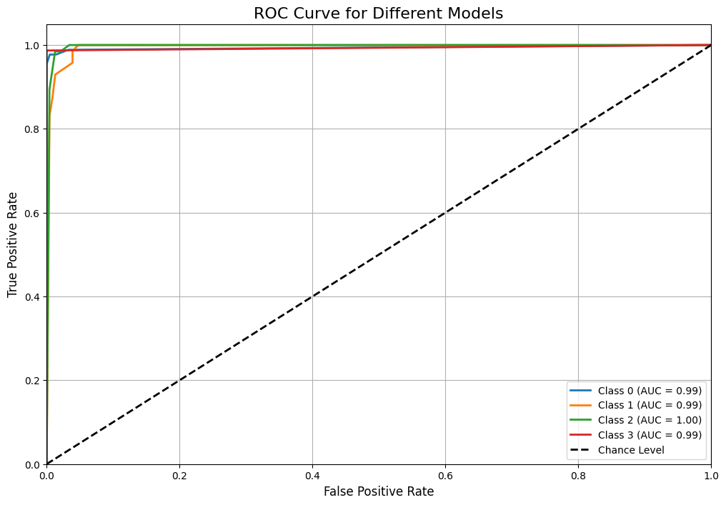
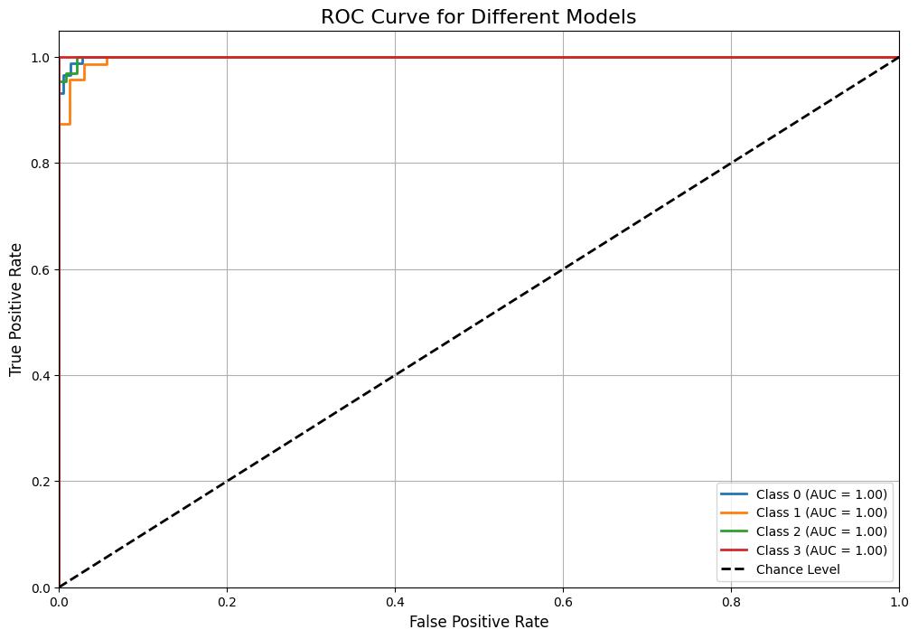
RESULTS & ANALYSIS
Roc Curve for Decision Tree Roc Curve for SVC

Slide 22
CONCLUSION and FUTURE SCOPE
Conclusion and Future work
This study focused on mobile phone features and pricing, identifying Bluetooth support, battery capacity, and weight as key factors. Among the 11 models evaluated, Decision Tree and SVC achieved the highest accuracy at 97.01% and 97.35%, respectively, offering a good balance between accuracy, flexibility, and time complexity.
Future work can improve model accuracy by exploring hyperparameter tuning approaches like Random Search, Bayesian Optimization, and Gradient-based Optimization. Testing models on diverse geographic datasets and incorporating real-time data feeds will enhance robustness and generalization. Additionally, applying ensemble learning, such as stacking with deep learning models, can further boost accuracy. Exploring SHAP or LIME for model interpretability could help make predictions clearer to stakeholders, and building a recommendation system for personalized smartphone selection could offer real-time, user-specific suggestions.

Slide 23
REFERENCES
[1] C. Fu, Y. Zheng, S. Li, Q. Xuan, and Z. Ruan, “Predicting
the popularity of tags in stackexchange qa communities,” in
2017 International Workshop on Complex Systems and Networks
(IWCSN), 2017, pp. 90– 95.
[2] F. Bodendorf, S. Merbele, and J. Franke, “Deep learning based
cost estimation of circuit boards: a case study in the automotive
industry,” Int. J. Prod. Res., vol. 60, no. 23, pp. 6945–6966, 2022.
[3] Khan, M., & Asim, A. (2021). Application of SVM and Logistic
Regression in Mobile Phone Price Prediction. Journal of Com-
putational Science and Engineering, 7(3), 1-9.
[4] Zhang, Y., Li, X., & Wang, J. (2021). Comparing Ensemble
Methods for Mobile Phone Price Prediction: Random Forests
vs. Decision Trees. International Journal of Production Research,
60(23), 6945-6966.
[5] Fofanah, M. (2021). Deep Learning in Mobile Phone Price
Prediction: A CNN-Based Approach. IEEE Access, 9, 123456-
123466.
[6] Sharma, P., & Verma, S. (2022). Enhancing Mobile Phone Price
Prediction Using Stacking and AdaBoost. IEEE Transactions on
Artificial Intelligence, 13(1), 89-99.
[7] Sharma, C., I. Batra, S. Sharma, A. Malik, A. S. M. S. Hosen,
& I.-H. Ra. (2022). Predicting Trends and Research Patterns of
Smart Cities: A Semi-Automatic Review Using Latent Dirichlet
Allocation (LDA). IEEE Access, 10, 123789-123800.
[8] M.Sireesha, S. N. TirumalaRao, Srikanth Vemuru, Frequent Item-
set Mining Algorithms: A Survey Journal of Theoretical and
Applied Information Technology Vol - 96, No .3, Feb - 2018
ISSN - 1992-8645, Pages – 744 – 755
[9] Sireesha Moturi, S.N.Tirumala Rao, Srikanth Vemuru,Grey wolf
assisted dragonfly-based weighted rule generation for predicting
heart disease and breast cancer, Computerized Medical Imaging
and Graphics, Volume 91, 2021, 101936, ISSN 0895-6111,
https://doi.org/10.1016/j.compmedimag.2021.101936.
[10] T. Sharma, U. Kaur, and S. Sharma, “Inclusive and Relative
Analysis of Nature Inspired Optimization Algorithms in Refer-
ence to Sworn Intelligence,” in 2022 8th International Conference
on Signal Processing and Communication (ICSC), 2022, pp.
397–403.
[11] M. Kumar, C. Sharma, S. Sharma, N. Nidhi, and N. Islam,
“Analysis of Feature Selection and Data Mining Techniques to
Predict Student Academic Performance,” in 2022 International
Conference on Decision Aid Sciences and Applications (DASA),
2022, pp. 1013–1017.
[12] B. Charbuty and A. Abdulazeez, “Classification based on deci-
sion tree algorithm for machine learning,” J. Appl. Sci. Technol.
Trends, vol. 2, no. 01, pp. 20–28, 2021.
[13] Moturi, S., Vemuru, S., Tirumala Rao, S.N., Mallipeddi, S.A.
(2023). Hybrid Binary Dragonfly Algorithm with Grey Wolf
Optimization for Feature Selection. In: Hassanien, A.E., Castillo,
O., Anand, S., Jaiswal, A. (eds) International Conference on In-
novative Computing and Communications. ICICC 2023. Lecture
Notes in Networks and Systems, vol 703. Springer, Singapore.
https://doi.org/10.1007/978-981-99-3315-0 47
[14] Sireesha Moturi , Srikanth Vemuru, S. N. Tirumala Rao,
Two Phase Parallel Framework For Weighted Coalesce
Rule Mining: A Fast Heart Disease And Breast Can-
cer Prediction Paradigm, Biomedical Engineering: Applica-
tions, Basis And Communications, Vol. 34, No. 03 (2022),
https://doi.org/10.4015/S1016237222500107

Slide 24
QUESTIONS and ANSWERS
Open the floor for questions from the audience

Slide 25
ACKNOWLEGEMENTS
THANK YOU

